Slide 1


Slide 2


Let every worker…, study, plan, devise methods, to reach the people where they are. We must do something out of the common course of things. We must arrest the attention. We must be deadly in earnest. We are on the very verge of times of trouble and perplexities that are scarcely dreamed of.
Evangelism, p. 122

Slide 3





The Messiah All Media
September 2027
Prayer Initiatives Prophetic Books The Desire of Ages
Church Mobilization Bible Study Requests Harvest Events

Slide 4


THE DESIRE OF AGES
Spend a thoughtful hour each day in contemplation of the life of Christ.
The Desire of Ages, p. 83

Slide 5
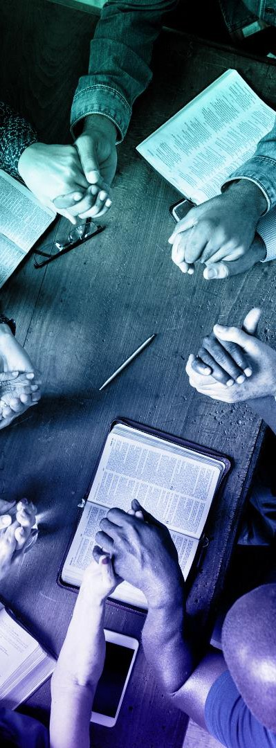
40 Days of Prayer
July 23 - August 31, 2027

Slide 6


Global Priorities
Chanmin Chung

Slide 7

PROPHETIC BOOKS
Missionary Book of the Year
Daniel & Revelation

Slide 8
The Messiah All Media
September 2027
Prayer Initiatives Prophetic Books The Desire of Ages
Church Mobilization Bible Study Requests Harvest Events

Slide 9

Strategic Cities
Istanbul
Kolkata
Bangkok
Tokyo
Jakarta
Shanghai
Dhaka
Tashkent
Kano (Nigeria)
Cairo
Delhi
Taipei
Ho Chi Minh City
Kuala Lumpur
Haifa
Paris
Athens
London
Chicago
Sydney
Sana’a (Yemen)
Tehran
Kabul
Mogadishu
Riyadh
Karachi

Slide 10
Secular & Post-Christian Cities
Paris (EUD
Athens (TED)
London (TED)
Chicago (NAD)
Toronto (NAD)
Sydney (SPD)
Mexico City (IAD)
Montevideo (SAD) 9.Buenos Aires (SAD)
10. Johannesburg
(SID)

Slide 11

Revelation 21:1-5
1 Then I saw a new heaven and a new earth, for the first heaven and the first earth had passed away, and the sea was no more. 2 And I saw the holy city, new Jerusalem, coming down out of heaven from God, prepared as a bride adorned for her husband. 3 And I heard a loud voice from the throne saying, “Behold, the dwelling place of God is with man. He will dwell with them, and they will be his people, and God himself will be with them as their God. 4 He will wipe away every tear from their eyes, and death shall be no more, neither shall there be mourning, nor crying, nor pain anymore, for the former things have passed away.”
5 And he who was seated on the throne said, “Behold, I am making all things new.” Also he said,
“Write this down, for these words are trustworthy and true.”

Slide 12


Slide 13
Primary Objectives
Reach Seekers
Introduce seekers to Jesus through compelling, shareable media that meets them where they are
Equip Members
Provide frontline members with ready-to- share content that makes personal evangelism simple and effective

Slide 14
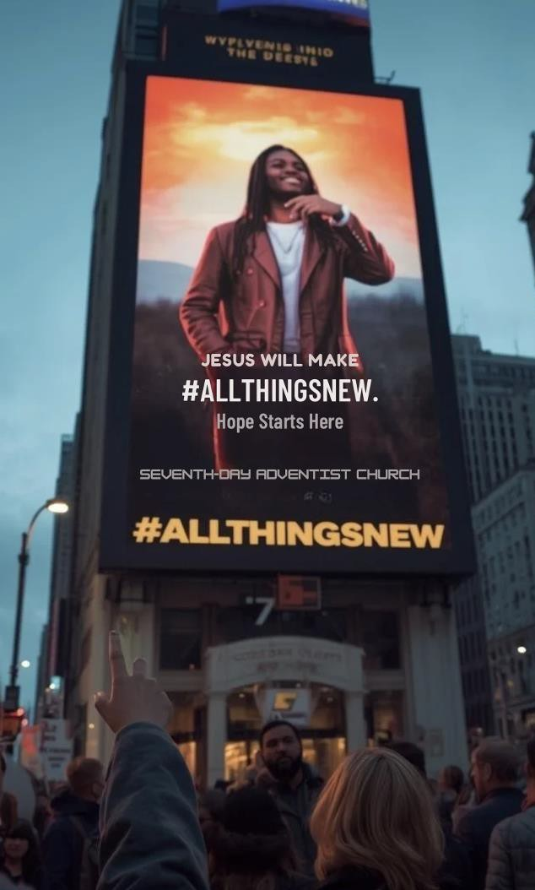

Global Digital Billboards and Signage Campaign

Slide 15
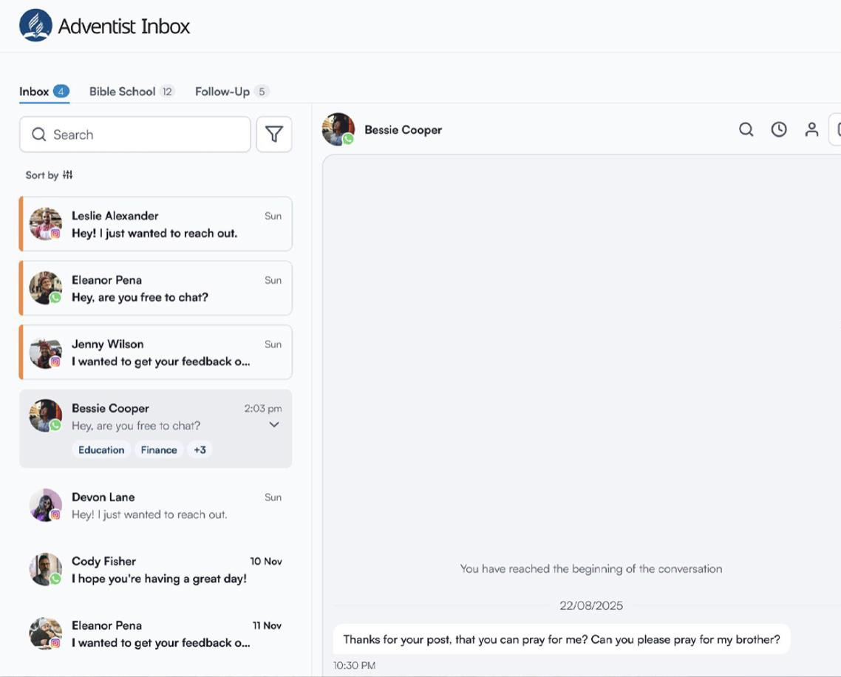


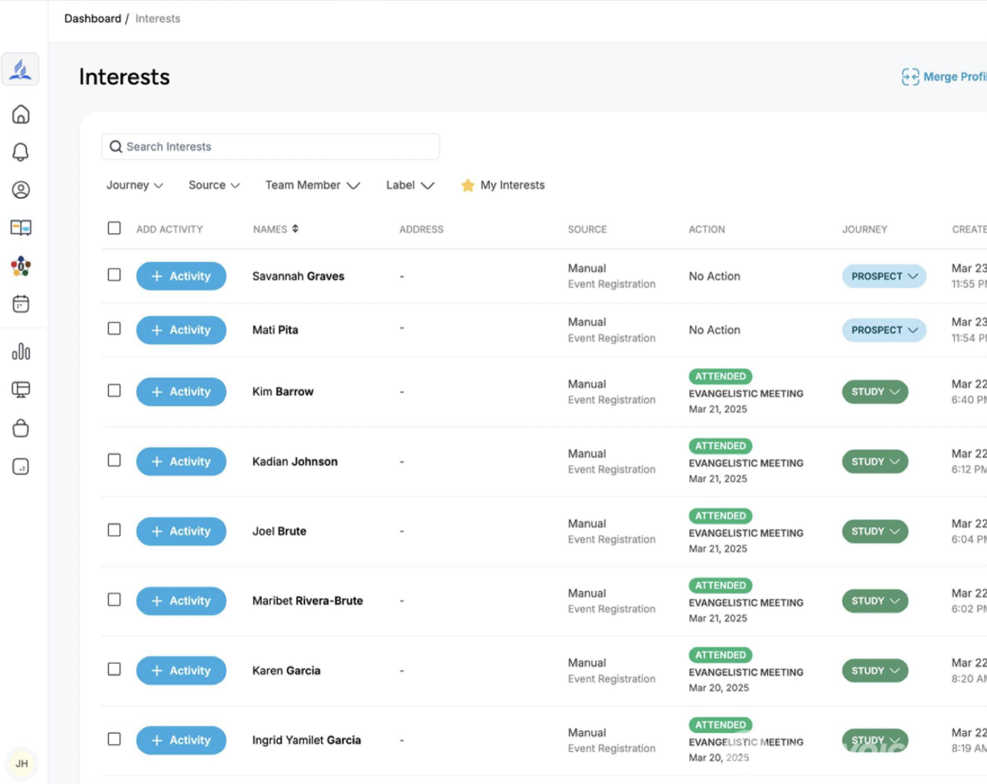


Generate Interests
Automated Bible Studies
Deliver Interests to Local Churches
Interest trackers & ACMS

Slide 16


HARVEST EVENTS
Every church hosts harvest events, welcoming viewers and listeners from every media platform.
Members establish home groups within their communities.

Slide 17

The Women’s Ministries Department will Participate
in OneVoice27!

Slide 18
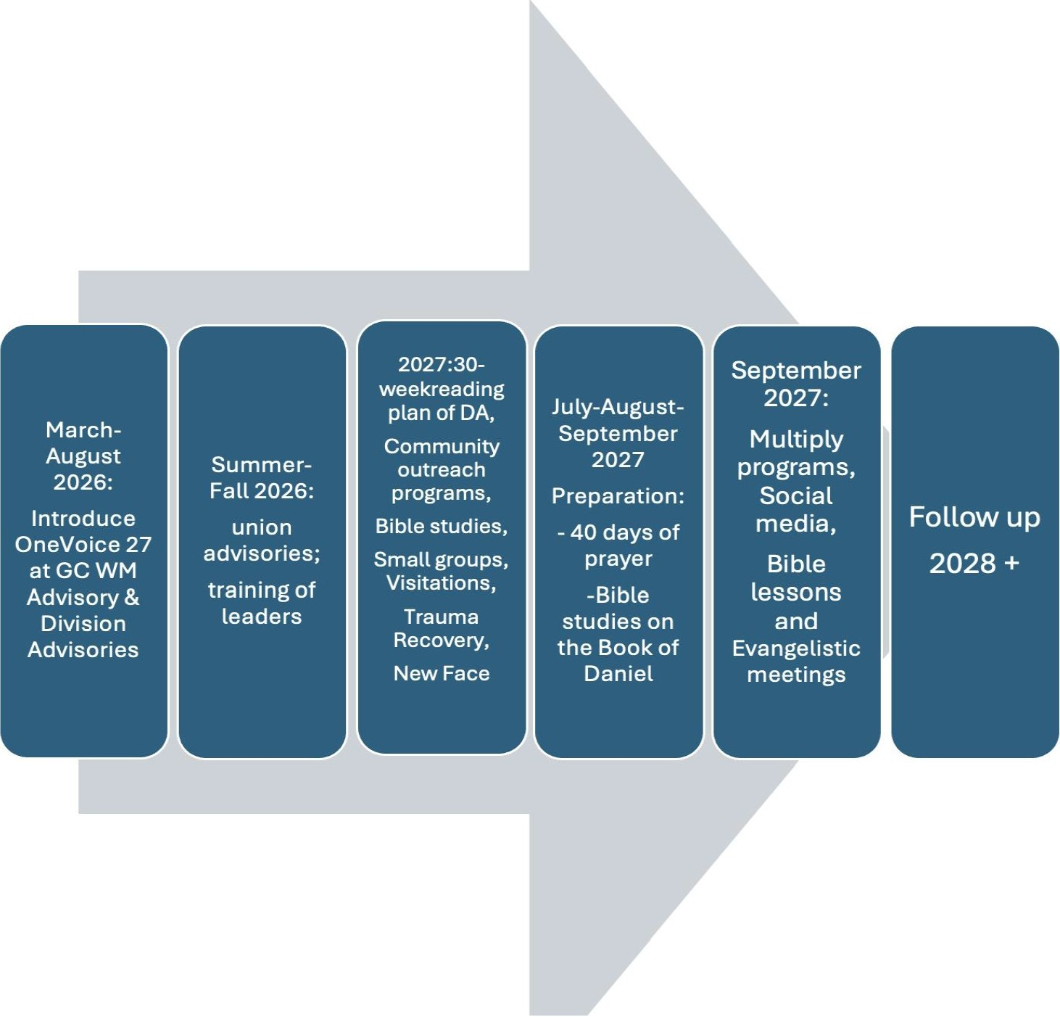
Tentative Plan of the WM Participation in OneVoice27

Slide 19

Then a third angel followed them, saying with a loud voice…
Revelation 14:9

Slide 20

If we want to preach in a loud voice, we need to preach in
One Voice

